Slide 1
Functions An Introduction
ICS 3U0

Slide 2
Today’s Agenda
Learn about functions in general - what they are and why they are used in programs
Learn how to write functions without parameters
Learn how to write functions with parameters

Slide 3
What is a Function?
A function is like a recipe. It’s a set of instructions that you can refer to by name.
Functions are useful when you want to do the same thing several times: you just define a function once (like writing down a recipe) and then use it several times (like making several cakes with the same recipe).
All programming languages provide ways for developers to use/create functions - Python is no exception.

Slide 4
Built In Functions
The Python interpreter has a number of functions built into it that are always available for the developer to use. These are called built-in functions.
Examples: type(), print(), input() round(), int()
Note that we have been using built-in functions from the very first day that we programmed in Python

Slide 5
Functions from Built-in Modules
There are many modules available for Python developers to use. These modules provide even more functions to help developers with their coding tasks.
Example Modules: math module and random module Example Functions: math.sqrt(), math.sin(), random.randomint(), random.choice()
Note that since these functions are not built-in, we need to name the module that the functions belongs to when we call the function

Slide 6
Methods
Methods are just like functions, with two major differences:
Methods are defined inside a class definition in order to make the relationship between the class and the method explicit
The syntax for invoking a method is different from the syntax for calling a function
Examples : We have seen only a couple of methods in this course so far, for example ... string.lower(). We will see more methods in the Strings and Arrays Unit.
What does this mean? Python is an object-oriented programming language and for the most part, in this course, we don’t really need to know that. You will be learning more about OO programming languages in Grade 12. What I really want you to know is ...

Slide 7
User Defined Functions
A Python programmer can create their own functions
These functions are called user-defined functions
The idea is that if there is something that you want to do in your program, and there is no existing function that does it, then you can create the function yourself
The remainder of this unit/course is about teaching you how to create your own user-defined functions

Slide 8
Example – Our First Function
def happy():
print("Happy birthday to you!")
# Main program
happy()
happy()
print("Happy birthday, dear Fred!")
happy()
This code is NOT run until happy() is called
What do you think the output will be?
Why Functions are Cool Fact #1
Less code duplication

Slide 9
Revised Example
def happy():
print("Happy birthday to you!")
def sing():
happy()
happy()
print("Happy birthday, dear Fred!")
happy()
# Main program
sing()
What do you think the output will be?
Why Functions are Cool Fact #2
You can call functions inside other functions

Slide 10
Revised Example
def happy():
print("Happy birthday to you!")
def sing(name):
happy()
happy()
print("Happy birthday, dear", name + "!")
happy()
# Main program
sing("Chris")
What do you think the output will be?
Why Functions are Cool Fact #3
You can pass information into functions called parameters

Slide 11
Functions – The Details
Functions are created using the following syntax.
def nameoffunction(parameters):
do something
do something else
blah blah blah
A function has two main components: the heading, and the body.
Heading
Body

Slide 12
Functions – The Details
The heading contains the def keyword, which tells Python that a new function is being defined. It also contains the name of the function, which uniquely identifies it within a program, and a list of parameters — variables that will be assigned values that are passed to the function.
Like if statements and loops, the body is indented. It contains the code that is to be executed each time the function is called.

Slide 13
Functions – The Details
A function is called by using its name followed by a list of parameters in brackets – example – sing("Chris")
When Python comes to a function call, a four-step process is initiated:
Program execution is suspended at the point of the call
The parameters of the function get assigned the values supplied by the actual parameters in the call
The body of the function is executed
Control returns to the point just after where the function was called

Slide 14
Tracing Happy Birthday
Let's trace our Happy Birthday program with UofWaterloo's Python visualizer
http://cscircles.cemc.uwaterloo.ca/visualize

Slide 15
Let’s Write Some Functions!
Write a function called login() that will ask for a username and password. Validate their user name and password and print an appropriate message. Call this function from the main program.
Write a function called average() that will ask the user for five marks. Print the average of these marks. Call this function from the main program.

Slide 16
Exercises – Intro Functions
Complete Exercise 4.1 – Day 1

Slide 17
More About Parameters
All of the functions that you wrote last night did not have parameters. For example: count_down(). That is, when this function was called in the main program, there was no text in the brackets.
Using parameters in our functions allows the main program to pass in information to the function
Using parameters effectively is an important part of learning how to develop useful functions

Slide 18
More About Parameters
No parameter is passed into this function. When this function is called, all of the code within the body of the function is simply run.
def print_hello():
print("Hello")
def print_welcome(name):
print("Welcome",name)
# Main program
print_hello()
print_welcome("Fred")
print_hello()
print_welcome("Barney")
This function has a parameter called “name”. When this function is called, whatever value is passed in is used and stored in the variable called “name” when the code within the body of the function is run.

Slide 19
Example - Using for and random
Write a program that displays the sum of 4 random dice.
import random
sum = 0
for roll in range(4):
sum += random.randint(1,6)
print("The sum is", sum)

Slide 20
Example – Create a Function
Now, write a function that calculates the sum of 4 dice and prints the result. Call the function in the main program.
import random
def sum_dice():
sum = 0
for roll in range(4):
sum += random.randint(1,6)
print("The sum is", sum)
# Main Program
sum_dice()
This function has no parameters. This means that no information is being passed into the function from the main program –hence the empty brackets.

Slide 21
Example – Create a Better Function
Now, write a function that calculates the sum of n dice and prints the result. Test your function in the main program with these values: 5, 2 and 10.
import random
def sum_dice(n):
sum = 0
for roll in range( ):
sum += random.randint(1,6)
print("The sum is", sum)
# Main Program
sum_dice(5)
sum_dice(2)
sum_dice(10)
4
n
This function has one parameter: n. This means that the value of n inside the function will be assigned the value of the parameter when the function is called in the main program.

Slide 22
More About Functions
Anytime we want to roll any number of dice, we simply call the sum_dice function and supply it a different number
Learning how to program with functions will make your code reusable since once a function is defined, it can be used over and over and over again
It will also help to develop an appreciation about how using functions provides a tool for splitting very large applications/problems into pieces that have a well-defined role

Slide 23
More About Functions
While functions could be defined anywhere in the program, it is common practice to define all functions near the top of the program, and leave the “main” part of the program to the end
This is so that anyone who is reading your code does not have to search through the entire program trying to find where the function has been defined. It must be somewhere toward the beginning of the code.
Developers call the main part of the program: "main"

Slide 24
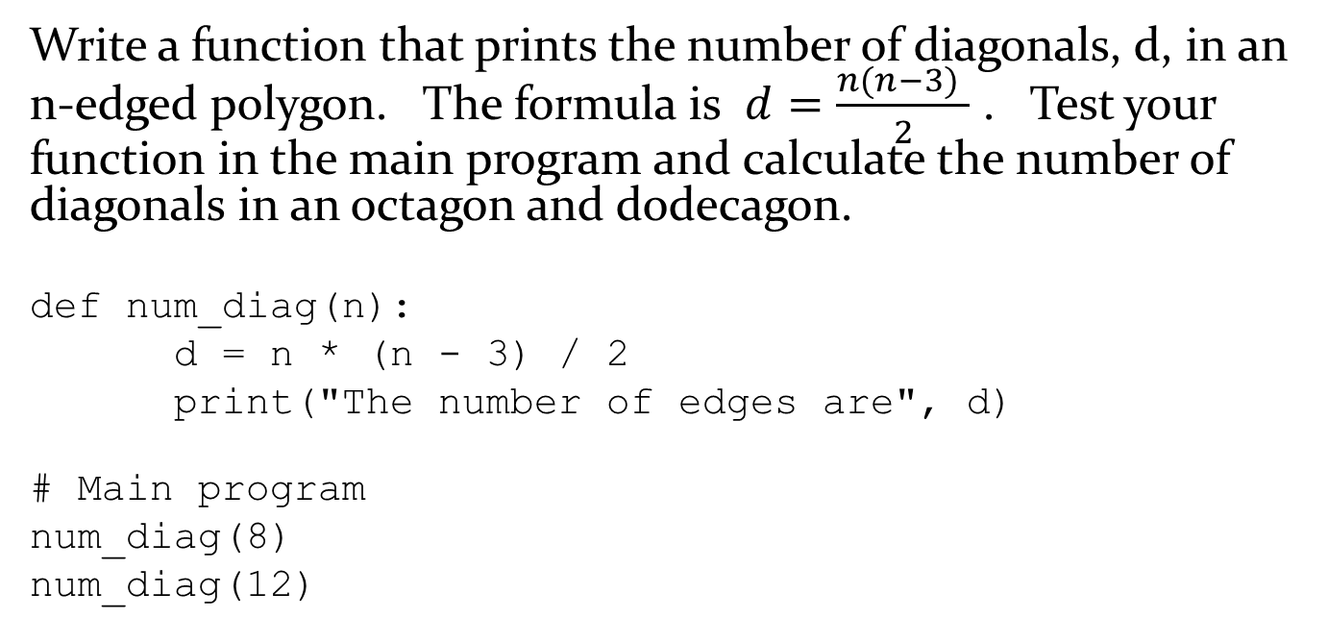
You try!
Write a function that prints the number of diagonals, d, in an n-edged polygon. The formula is $d=\frac{n(n−3) }{2}$ . Test your function in the main program and calculate the number of diagonals in an octagon and dodecagon.
def num_diag(n):
d = n * (n - 3) / 2
print("The number of edges are", d)
# Main program
num_diag(8)
num_diag(12)

Slide 25
Functions with Multiple Parameters
There is really nothing different that we need to do if we want to pass in more than one parameter to a function. Consider the following simple function.
def print_two_things(x, y):
print('x is', x)
print('y is', y)
# Main program
print_two_things("Hello", "world!")

Slide 26
Example – You try!
Write a function called print_min(x, y)which takes two integer parameters and prints the lowest of the two values to the screen. Test your function in the main program with the values -5,6 and 5,0
Write a function called print_area(l, w) which takes two floating point parameters, length and width. The function should calculate the area and print the result to the screen. Test your function in the main program with the values 5,6 and 8.9,5.5

Slide 27
Exercises – Intro Functions
Complete Exercise 4.1 – Day 2

